Slide 1
TEMPO/GEMS Joint Meeting
Diurnal SO₂ observations from anthropogenic sources in Asia using GEMS and comparisons with low Earth orbit satellites
Hanlim Lee¹⁾ , Jeonghyeon Park¹⁾, Hyunkee Hong²⁾, Jhoon Kim³⁾, Wonjin Lee²⁾, Nicolas Theys⁴⁾, Can Li⁵⁾, Nickolay A. Krotkov⁵⁾ Dongwon Lee²⁾, Myungsoo Yoo⁶⁾, Hanseung Kum⁶⁾
¹ Pukyong National University, Busan, South Korea
² National Institute of Environmental Research, Environmental Satellite Center, Incheon, South Korea
³ Department of Atmospheric Sciences, Yonsei University, Seoul, South Korea
⁴ Royal Belgian Institute for Space Aeronomy, Brussels, Belgium
⁵ NASA Goddard Space Flight Center, Greenbelt, MD, United States
⁶ National Institute of Environmental Research

Slide 2
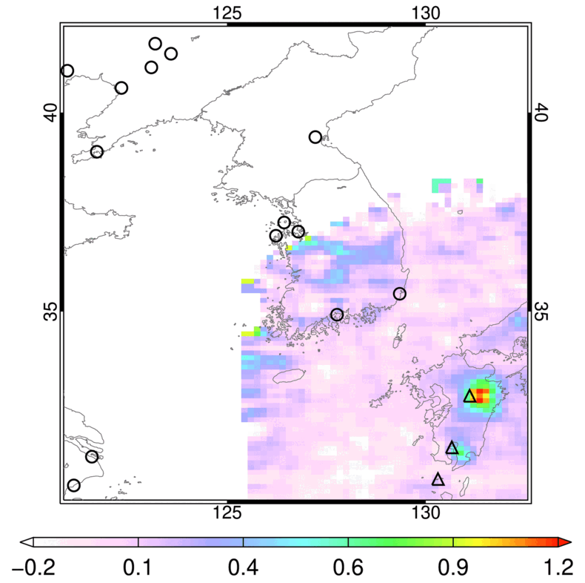
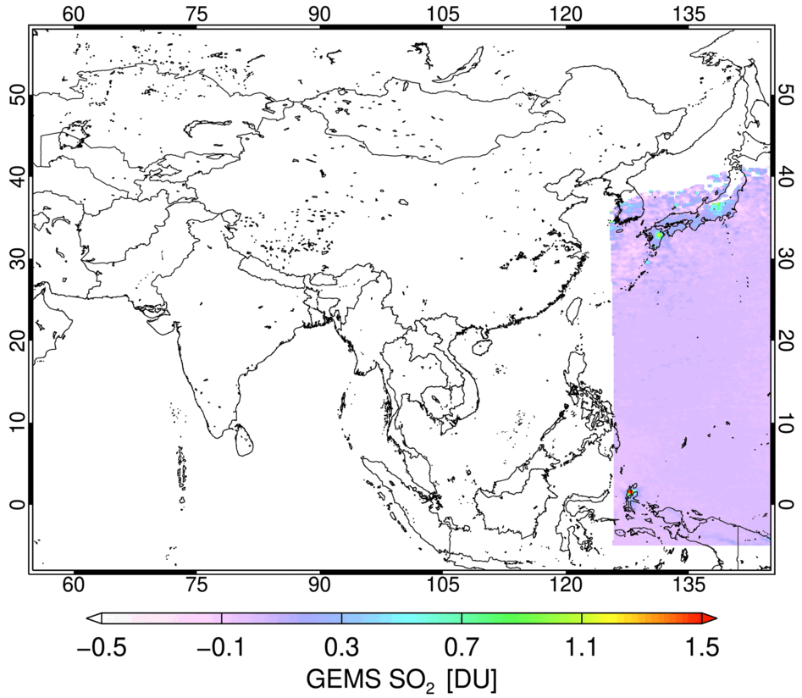
Overview on GEMS SO₂
The GEMS well captures the diurnal SO₂ generated from power plants and volcanoes
Jan. 2022
Gwangyang
Steelworks
(South Korea)
Aso Volcano
(Japan)
Sakura-jima
Volcano
(Japan)
Vindhyachai
Power plant
(India)
Taal volcano
(Philippines)
Neyveli
power plant
(India)
Korba
power plant
(India)
Dukono Volcano
(Indonesia)

Slide 3
Hybrid algorithm
The overall process of the Hybrid algorithm
SO₂, O₃ absorption cross-section
L1C Radiance, irradiance
CRF : Cloud Radiance Fraction(317nm)
ALH : Aerosol Layer Height
AOD : Aerosol Optical Depth
SZA : Solar Zenith Angle
VZA : Viewing Zenith Angle
RAA : Relative Azimuth Angle
AMF : Air Mass Factor
SCD : Slant Column Density
VCD : Vertical column Density
Part 3: Conversion to VCD with AMF
Scattering weight & CRF Look-up Table
SO₂ profile
Part 2: Final SO₂ SCD retrieval (PCA)
Geometry
(SZA, VZA, RAA)
DOAS
Select SO₂ Clean Sector
Surface reflectance
AOD, ALH
Initial SO₂ SCD
PCA
SO₂ AMF
Cloud Pressure
Cloud Fraction
Total O₃ VCD
Offset correction
Final SO₂ SCD
SO₂ VCD
Part 1: Initial SO₂ SCD retrieval (DOAS)

Slide 4
Hybrid algorithm
AMF Calculation Flowchart
Input data
[GEMS L2 Data]
Geometry
(SZA, VZA, RAA)
Aerosol Properties
Aerosol Properties
Surface reflectance
Surface reflectance
VLIDORT
Scattering weight & CRF LUT
Filtering LUT
Surface reflectance
AOD, ALH
Cloud Information
Cloud Pressure
Cloud Fraction
Ozone
Total O₃ VCD
SO₂ profile
(GEOS-Chem)
Substitute
GEMS L2 data with Climatology data
AMF
Climatology data
AOD : OMAERUV monthly mean AOD from 2005 to 2009
ALH : 2007 CALIOP-based aerosol height climatology
Surface reflectance : Lambertian equivalent reflector(LER) data
Ozone : Chemical transport model(CTM), Weather Research and Forecasting Chemistry model(WRF-Chem)

Slide 5
GEMS SO₂ V2.1 - Slant column density
V2.0
V2.1
Only the slit function data from one of the two CCDs was used
The slit function data averaged over the two CCDs was used
Difference
(V2.1 - V2.0)
VS.
06/2023 ~ 08/2023
Some SO₂ SCDs tend to show higher concentrations
Significant SO₂ SCD changes are observed in regions with high SZA
The stripe issue is expected to be improved through future optimization of SCD retrieval
12/2023 ~ 02/2024

Slide 6
GEMS SO₂ V2.1 - Air mass factor
V2.0
V2.1
GEMS L2 AOD (V2.1), BSR (V3.0), CLD (V3.0), O3T (V2.1) were used
Difference
(V2.1 - V2.0)
Version 2 input data was used
VS.
06/2023 ~ 08/2023
SO₂ AMF over the ocean has decreased by approximately 0.1
SO₂ AMF tends to increase across most continental regions during June to August 2023
SO₂ AMF has increased by approximately 0.2 in Southeast Asia (Indonesia, Malaysia, etc.)
12/2023 ~ 02/2024

Slide 7
GEMS SO₂ V2.1 - Air mass factor
V2.0
V2.1
GEMS L2 AOD (V2.1), BSR (V3.0), CLD (V3.0), O3T (V2.1) were used
Version 2 input data was used
VS.
Difference
(V2.1 - V2.0)
06/2023 ~ 08/2023
12/2023 ~ 02/2024
Previously, surface reflectance climatology data was used, but after using BSR data, a tendency for AMF to decrease was observed over Southeast China

Slide 8
GEMS SO₂ V2.1 - Vertical column density
V2.0
V2.1
Difference
(V2.1 - V2.0)
06/2023 ~ 08/2023
An increase in SO₂ AMF over India has led to an increase in SO₂ VCD by more than 1.5 DU
The SO₂ VCD changed in Southeast China
12/2023 ~ 02/2024
Notes:
CHANGED

Slide 9
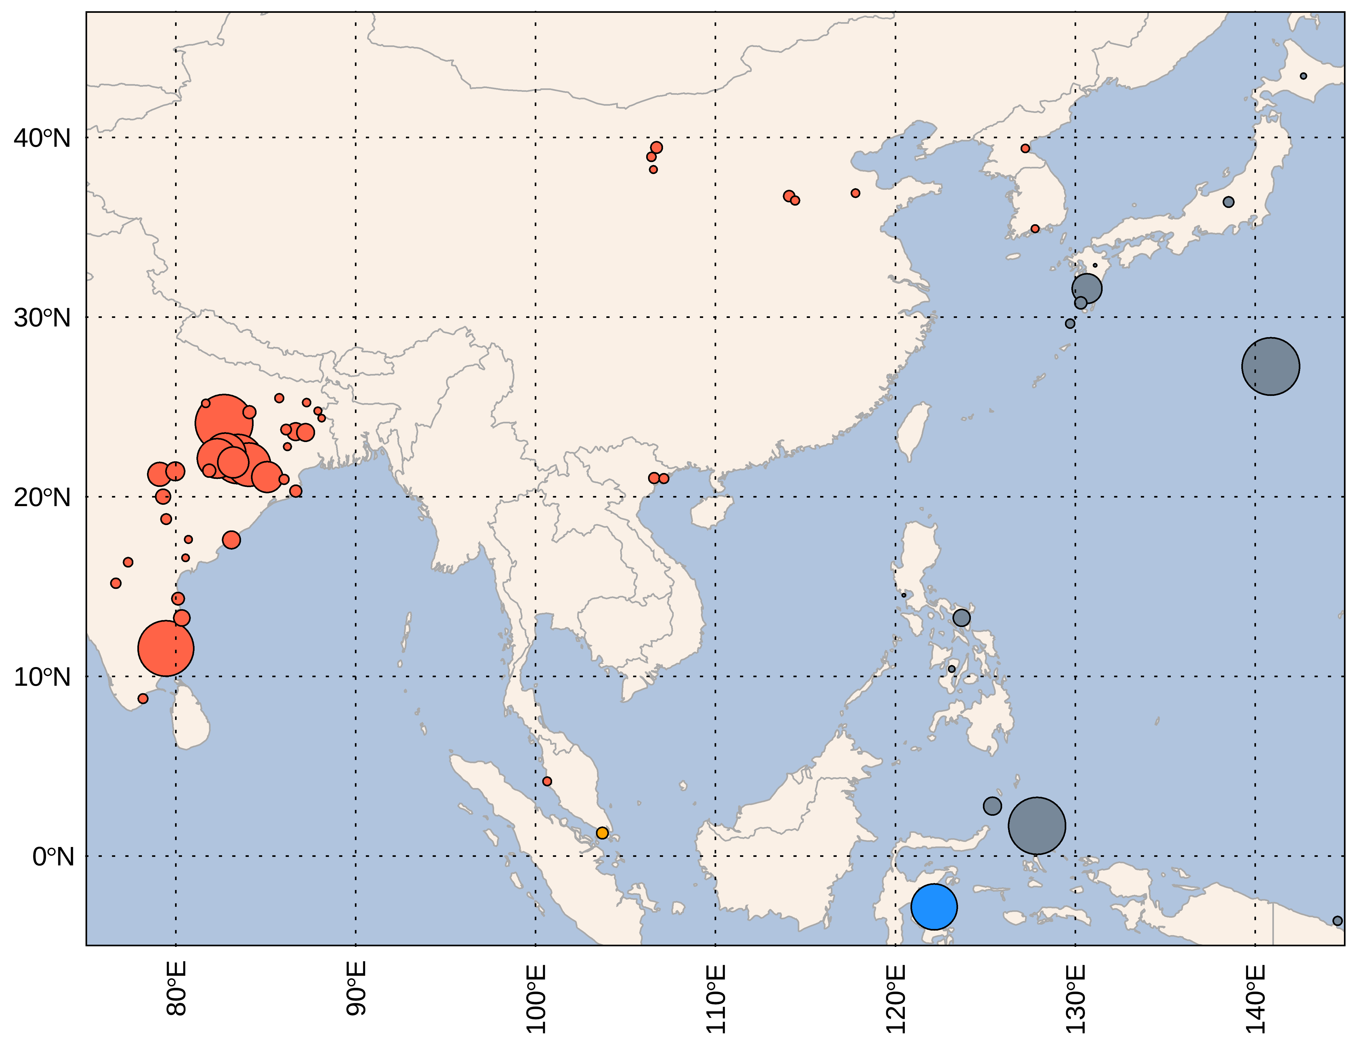
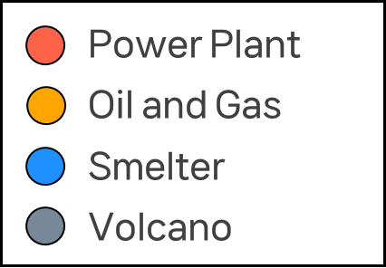
SO₂ hotspot in GEMS observation area
SO₂ Version 2 catalogue (Fioletov et al., 2022)
SO₂ concentrations at known emission sources was compared with those measure by LEO satellite
We used locations of emission sources with an 2023 annual output of more than 50 Kt
(Power plant - 44; Oil and Gas - 1; Smelter - 1; Volcano - 13)

Slide 10
12/2023 ~ 02/2024
OMI
OMPS
TROPOMI
Good agreements observed between GEMS and LEOs over India
GEMS
Talcher
(0.25°×0.25°)
Neyveli
Time [Local Time]
Time [Local Time]
SO₂ VCD [DU]

Slide 11
12/2023 ~ 02/2024
OMI
OMPS
TROPOMI
Good agreements observed between GEMS and LEOs over India
GEMS
Talcher
(0.25°×0.25°)
Neyveli
SO₂ VCD [DU]
*Comparison with low-orbit satellites using GEMS 04 UTC data from anthropogenic sources in India
Notes:
GEMS NO2 추가

Slide 12
12/2023 ~ 02/2024
OMI
OMPS
TROPOMI
Good agreements observed between GEMS and LEOs over Vietnam and Indonesia
Vietnam
GEMS
Indonesia
(0.25°×0.25°)
Hong Tach, Vietnam
Labota, Indonesia
SO₂ VCD [DU]
Time [Local Time]
Time [Local Time]
Notes:
Good agree ments
WHOWS GOOD AGREEMENT

Slide 13
OMI
OMPS
TROPOMI
Disagreements observed between GEMS and LEOs over China and Northeast Asia
GEMS
Unlike previous cases,
There is a difference in the spatial distribution compared to the LEO satellite
SO₂ VCD [DU]
*Comparison with low-orbit satellites using GEMS 04 UTC data from anthropogenic sources in India
Notes:
Correlation만 넣고
Disagreements observed between every satellites over China and North
선이랑 R을 제외

Slide 14
Comparison with LEO satellites
(12/2023 ~ 02/2024)
Comparison among LEO satellites
In hotspot areas, GEMS SO₂ concentrations tend to increase with V2.1 compared to V2.0

Slide 15
Comparisons w.r.t. SZA and VZA
Solar Zenith Angle
Viewing Zenith Angle
When the SZA is above 0.5 DU and SZA is 40 °, SO₂ VCD is retrieved to be higher
When the VZA is above 0.5 DU and SZA is 50 °, SO₂ VCD is retrieved to be higher
VCD > 0.5 DU & SZA < 40 ° excluding location
VCD > 0.5 DU & SZA < 40 ° excluding location
➔ The concentration range is similar, but the correlation decreases

Slide 16
Conclusions
India and South Asia (e.g. Vietnam and Indonesia) show good agreement when compared with LEO satellites
In China and Northeast Asia, all SO₂ concentrations from anthropogenic sources showed different spatial distributions for every LEO satellites (OMI, OMPS and TROPOMI)
– Cause identification and improvement in progress
When the SO₂ VCD is greater than 0.5 DU and either the SZA is greater than 40 ° or the VZA is greater than 50 °, GEMS SO₂ tends to be retrieved higher than that of LEO satellites
Please see the poster 51 by Jeonghyeon for the GEMS volcanic SO₂

Slide 17
Thank You !

